Slide 1
B+ Tree

Slide 2
Introduction of B+ Tree
B + Tree is a variation of the B-tree data structure.
In a B + tree, data pointers are stored only at the leaf nodes of the tree.
In a B+ tree structure of a leaf node differs from the structure of internal nodes.
The leaf nodes have an entry for every value of the search field, along with a data pointer to the record (or to the block that contains this record).
The leaf nodes of the B+ tree are linked together to provide ordered access to the search field to the records.
Internal nodes of a B+ tree are used to guide the search. Some search field values from the leaf nodes are repeated in the internal nodes of the B+ tree.

Slide 3
Features of B+ Trees
Balanced: B+ Trees are self-balancing, which means that as data is added or removed from the tree, it automatically adjusts itself to maintain a balanced structure. This ensures that the search time remains relatively constant, regardless of the size of the tree.
Multi-level: B+ Trees are multi-level data structures, with a root node at the top and one or more levels of internal nodes below it. The leaf nodes at the bottom level contain the actual data.
Ordered: B+ Trees maintain the order of the keys in the tree, which makes it easy to perform range queries and other operations that require sorted data.
Fan-out: B+ Trees have a high fan-out, which means that each node can have many child nodes. This reduces the height of the tree and increases the efficiency of searching and indexing operations.
Cache-friendly: B+ Trees are designed to be cache-friendly, which means that they can take advantage of the caching mechanisms in modern computer architectures to improve performance.
Disk-oriented: B+ Trees are often used for disk-based storage systems because they are efficient at storing and retrieving data from disk.

Slide 4
Why Use B+ Tree?
B+ Trees are the best choice for storage systems with sluggish data access because they minimize I/O operations while facilitating efficient disc access.
B+ Trees are a good choice for database systems and applications needing quick data retrieval because of their balanced structure, which guarantees predictable performance for a variety of activities and facilitates effective range-based queries.

Slide 5
Difference between B+ Tree and B Tree
Parameters | B+ Tree | B Tree
Structure | Separate leaf nodes for data storage and internal nodes for indexing | Nodes store both keys and data values
Leaf Nodes | Leaf nodes form a linked list for efficient range-based queries | Leaf nodes do not form a linked list
Order | Higher order (more keys) | Lower order (fewer keys)
Key Duplication | Typically allows key duplication in leaf nodes | Usually does not allow key duplication
Disk Access | Better disk access due to sequential reads in a linked list structure | More disk I/O due to non-sequential reads in internal nodes

Slide 6
Difference between B+ Tree and B Tree
Parameters | B+ Tree | B Tree
Applications | Database systems, file systems, where range queries are common | In-memory data structures, databases, general-purpose use
Performance | Better performance for range queries and bulk data retrieval | Balanced performance for search, insert, and delete operations
Memory Usage | Requires more memory for internal nodes | Requires less memory as keys and values are stored in the same node

Slide 7
Implementation of B+ Tree
In order, to implement dynamic multilevel indexing, B-tree and B+ tree are generally employed. The drawback of the B-tree is that it stores the data pointer, corresponding to a particular key value, along with that key value in the node of a B-tree, thereby contributing to the increase in the number of levels in the B-tree, hence increasing the search time of a record.
B+ tree eliminates the above drawback by storing data pointers only at the leaf nodes of the tree.
As data pointers are present only at the leaf nodes, the leaf nodes must necessarily store all the key values along with their corresponding data pointers to the disk file block, in order to access them.
Moreover, the leaf nodes are linked to providing ordered access to the records. The leaf nodes, therefore form the first level of the index, with the internal nodes forming the other levels of a multilevel index. Some of the key values of the leaf nodes also appear in the internal nodes, to simply act as a medium to control the searching of a record.
It is apparent that a B+ tree, unlike a B-tree, has two orders, ‘a’ and ‘b’, one for the internal nodes and the other for the external (or leaf) nodes.

Slide 8
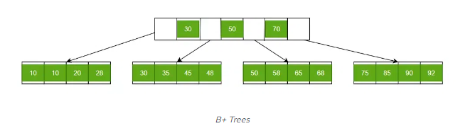
Structure of B+ Trees
B+ Trees contain two types of nodes:
Internal Nodes: Internal Nodes are the nodes that are present in at least n/2 record pointers, but not in the root node,
Leaf Nodes: Leaf Nodes are the nodes that have n pointers.

Slide 9
The Structure of the Internal Nodes of a B+ Tree of Order ‘a’
Each internal node is of the form: <P₁, K₁, P₂, K₂, ….., P_{c-1}, K_{c-1}, P_{c}> where c <= a and each P_{i} is a tree pointer (i.e points to another node of the tree) and, each K_{i} is a key-value
Every internal node has : K₁ < K₂ < …. < K_{c-1}
For each search field value ‘X’ in the sub-tree pointed at by P_{i}, the following condition holds: K_{i-1} < X <= K_{i}, for 1 < I < c and, K_{i-1} < X, for i = c
Each internal node has at most ‘aa tree pointers.
The root node has, at least two tree pointers, while the other internal nodes have at least \ceil(a/2) tree pointers each.
If an internal node has ‘c’ pointers, c <= a, then it has ‘c – 1’ key values.

Slide 10
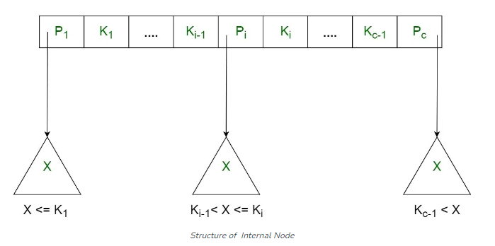
The Structure of the Internal Nodes of a B+ Tree of Order ‘a’

Slide 11
The Structure of the Leaf Nodes of a B+ Tree of Order ‘b’
Each leaf node is of the form: <<K₁, D₁>, <K₂, D₂>, ….., <K_{c-1}, D_{c-1}>, P_{next}> where c <= b and each D_{i} is a data pointer (i.e points to actual record in the disk whose key value is K_{i} or to a disk file block containing that record) and, each K_{i} is a key value and, P_{next} points to next leaf node in the B+ tree
Every leaf node has : K₁ < K₂ < …. < K_{c-1}, c <= b
Each leaf node has at least \ceil(b/2) values.
All leaf nodes are at the same level.

Slide 12
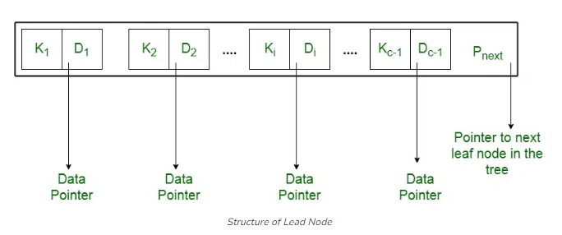
The Structure of the Leaf Nodes of a B+ Tree of Order ‘b’

Slide 13
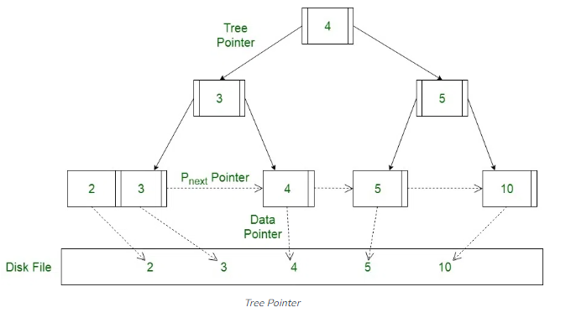
Using the P_{next} pointer it is viable to traverse all the leaf nodes, just like a linked list, thereby achieving ordered access to the records stored in the disk.

Slide 14
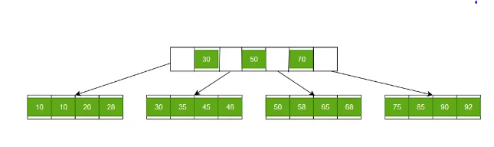
Searching a Record in B+ Trees
Let us find 58 in the B+ Tree. Start by fetching from the root node then move to the leaf node, which might contain a record of 58.
In the image given, 58 between 50 and 70. Therefore, we will get a leaf node in the third leaf node and get 58 there.

Slide 15
Insertion in a B+ tree
During insertion following properties of B+ Tree must be followed:
Each node except root can have a maximum of M children and at least ceil(M/2) children.
Each node can contain a maximum of M – 1 keys and a minimum of ceil(M/2) – 1 keys.
The root has at least two children and atleast one search key.
While insertion overflow of the node occurs when it contains more than M – 1 search key values.
Here M is the order of B+ tree.

Slide 16
Steps for insertion in B+ Tree
Every element is inserted into a leaf node. So, go to the appropriate leaf node.
Insert the key into the leaf node in increasing order only if there is no overflow. If there is an overflow go ahead with the following steps mentioned below to deal with overflow while maintaining the B+ Tree properties.

Slide 17
Properties for insertion B+ Tree
Case 1: Overflow in leaf node
Split the leaf node into two nodes.
First node contains ceil((m-1)/2) values.
Second node contains the remaining values.
Copy the smallest search key value from second node to the parent node.(Right biased)

Slide 18
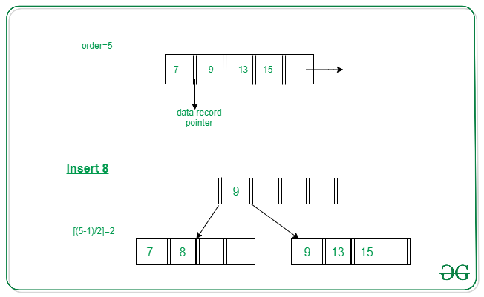
Properties for insertion B+ Tree
inserting 8 into B+ Tree of order of 5

Slide 19
Properties for insertion B+ Tree
Case 2: Overflow in non-leaf node
Split the non leaf node into two nodes.
First node contains ceil(m/2)-1 values.
Move the smallest among remaining to the parent.
Second node contains the remaining keys.

Slide 20
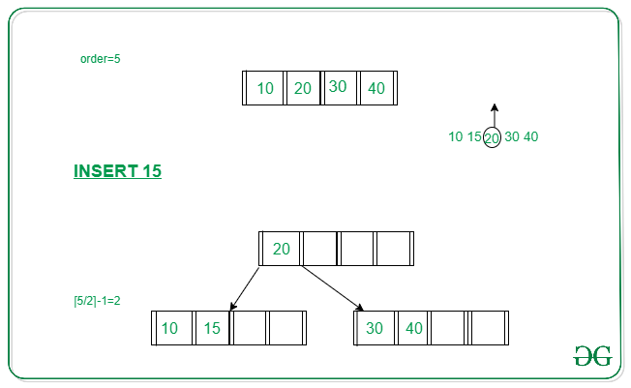
Properties for insertion B+ Tree
inserting 15 into B+ Tree of order of 5

Slide 21
Example to illustrate insertion on a B+ tree
Problem: Insert the following key values
6, 16, 26, 36, 46 on a B+ tree with order = 3. Solution: Step 1: The order is 3 so at maximum in a node so there can be only 2 search key values. As insertion happens on a leaf node only in a B+ tree so insert search key value 6 and 16 in increasing order in the node.

Slide 22
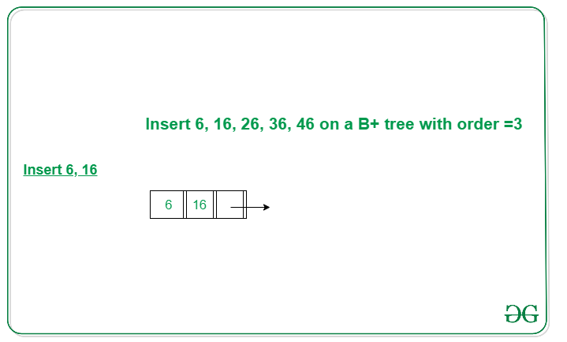
Example to illustrate insertion on a B+ tree

Slide 23
Example to illustrate insertion on a B+ tree
Step 2: We cannot insert 26 in the same node as it causes an overflow in the leaf node, We have to split the leaf node according to the rules. First part contains ceil((3-1)/2) values i.e., only 6. The second node contains the remaining values i.e., 16 and 26. Then also copy the smallest search key value from the second node to the parent node i.e., 16 to the parent node.

Slide 24
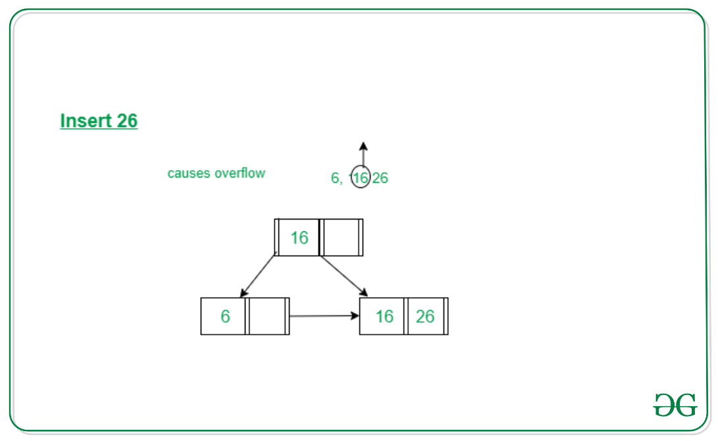
Example to illustrate insertion on a B+ tree

Slide 25
Example to illustrate insertion on a B+ tree
Step 3: Now the next value is 36 that is to be inserted after 26 but in that node, it causes an overflow again in that leaf node. Again follow the above steps to split the node. First part contains ceil((3-1)/2) values i.e., only 16. The second node contains the remaining values i.e., 26 and 36. Then also copy the smallest search key value from the second node to the parent node i.e., 26 to the parent node.

Slide 26
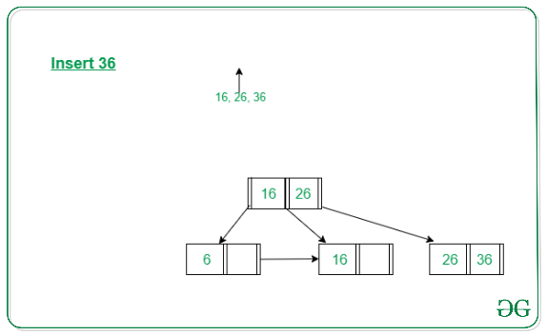
Example to illustrate insertion on a B+ tree

Slide 27
Example to illustrate insertion on a B+ tree
Step 3: Now the next value is 36 that is to be inserted after 26 but in that node, it causes an overflow again in that leaf node. Again follow the above steps to split the node. First part contains ceil((3-1)/2) values i.e., only 16. The second node contains the remaining values i.e., 26 and 36. Then also copy the smallest search key value from the second node to the parent node i.e., 26 to the parent node.

Slide 28
Example to illustrate insertion on a B+ tree
Step 4: Now we have to insert 46 which is to be inserted after 36 but it causes an overflow in the leaf node. So we split the node according to the rules. The first part contains 26 and the second part contains 36 and 46 but now we also have to copy 36 to the parent node but it causes overflow as only two search key values can be accommodated in a node. Now follow the steps to deal with overflow in the non-leaf node. First node contains ceil(3/2)-1 values i.e. ’16’. Move the smallest among remaining to the parent i.e ’26’ will be the new parent node. The second node contains the remaining keys i.e ’36’ and the rest of the leaf nodes remain the same.

Slide 29
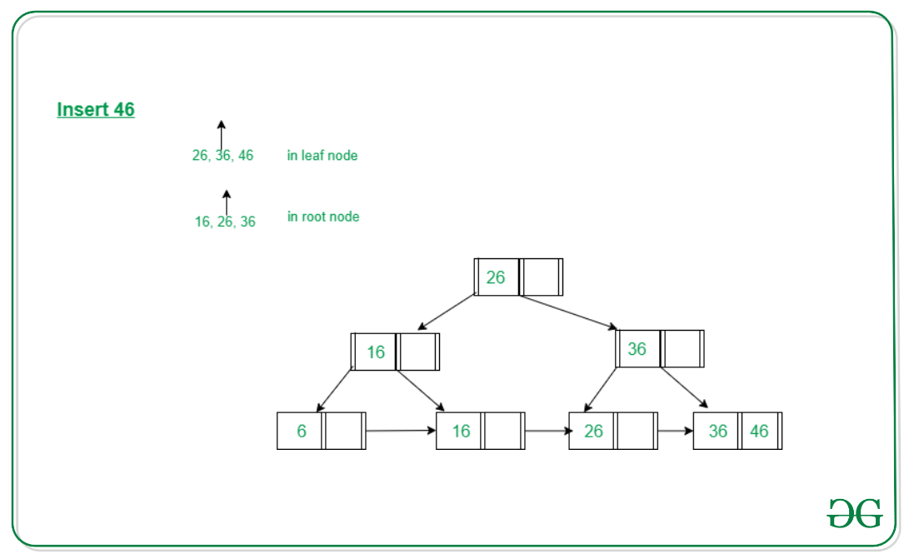
Example to illustrate insertion on a B+ tree

Slide 30
Deletion in B+ Trees
Deletion in B+ Trees is just not deletion but it is a combined process of Searching, Deletion, and Balancing.
In the last step of the Deletion Process, it is mandatory to balance the B+ Trees, otherwise, it fails in the property of B+ Trees.
A key-value pair is deleted from a B+ tree using this method. In order to keep the attributes of the tree’s internal nodes after performing the deletion operation, the appropriate leaf node and its key-value pair must be removed.

Slide 31
The deletion strategy for the B+ tree
Look to locate the deleted key in the leaf nodes.
Delete the key and its associated value if the key is discovered in a leaf node.
One of the following steps should be taken if the node underflows (number of keys is less than half the maximum allowed):
Get a key by borrowing it from a sibling node if it contains more keys than the required minimum.
If the minimal number of keys is met by all of the sibling nodes, merge the underflow node with one of its siblings and modify the parent node as necessary.
Remove all references to the deleted leaf node from the internal nodes of the tree.
Remove the old root node and update the new one if the root node is empty.

Slide 32
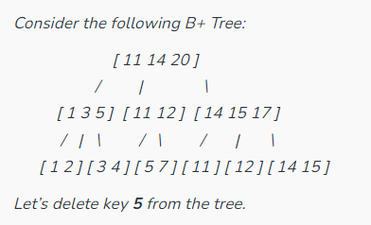
Illustration

Slide 33
Illustration
Look in the leaf nodes for the key number 5. The node [1 3 5] contains the key.
Remove the value associated with the key 5, creating the node [1 3].
The node [1 3] underflows because it contains fewer keys than the maximum number permitted. From its sibling node, we can obtain a key [3 4]. We borrow key 4 in this instance, resulting in the nodes [1 3 4] and [5 7].
Remove all references to the deleted leaf node from the internal nodes of the tree. We must delete the reference to the node [1 3 5] from its parent node [1 3 4 11] because it was merged with the node [5 7]. The node [1 3 4 11] is the consequence of this.
The deletion is finished since the root node [11 14 20] is not empty.

Slide 34
Advantages of B+ Trees
A B+ tree with ‘l’ levels can store more entries in its internal nodes compared to a B-tree having the same ‘l’ levels. This accentuates the significant improvement made to the search time for any given key. Having lesser levels and the presence of P_{next} pointers imply that the B+ trees is very quick and efficient in accessing records from disks.
Data stored in a B+ tree can be accessed both sequentially and directly.
It takes an equal number of disk accesses to fetch records.
B+trees have redundant search keys, and storing search keys repeatedly is not possible.

Slide 35
Disadvantages of B+ Trees
The major drawback of B-tree is the difficulty of traversing the keys sequentially. The B+ tree retains the rapid random access property of the B-tree while also allowing rapid sequential access.

Slide 36
Application of B+ Trees
Multilevel Indexing
Faster operations on the tree (insertion, deletion, search)
Database indexing

